Slide 1



Amazon Sales Data Analysis
Presenter Name : Yogita Khillari

Slide 2
Agenda
Introduction
Challenge Statement
Process(Data Analysis)
Data Insight
Summary
Presentation Title

Slide 3

Introduction
Amazon.com is an e-commerce platform that sells many product lines, including media (books, movies, music, and software), apparel, baby products, consumer electronics, beauty products, gourmet food, groceries, health and personal care products.
In August 2019, Amazon applied to have a liquor store in San Francisco, as a means to ship beer and alcohol within the city. In 2020, Amazon Fresh opened several physical stores in the U.S. and the United Kingdom.
E-commerce analytics refers to the process of collecting, analyzing, and interpreting data related to online activities by tracking metrics and key performance indicators (KPIs) to gain insights into customer behavior, sales, marketing, and overall business operations in the digital marketplace

Slide 4
Challenge Statement
Objective: Sales management has gained importance to meet increasing competition and the need for improved methods of distribution to reduce cost and to increase profits. The goal is to identify trends and patterns in Amazon sales data, analyzing data and trends to increase online sales and improve customer experience.
Scope and Objective:
Conduct research and analyze data to identify trends and opportunities in the Ecommerce industry and increase online sales and improve customer experience
Monitor and report on Ecommerce metrics, such as traffic, revenue, and customer behavior.
Data analysis is to extract actionable insights from raw data, enabling organizations to make informed choices and predictions.
Inspecting, cleaning, transforming, and modeling data with the goal of discovering useful information, drawing conclusions, and supporting decision-making.
Retailers leverage data analysis to optimize inventory management to meet customer demand efficiently. By analyzing historical sales data, seasonal trends, and external factors such as economic indicators, to forecast demand for specific products and adjust their inventory levels accordingly.

Slide 5



The data set :The data has been collected in form of .csv file , Name as “Amazon Sales data “ . The data set covers wide range of amazon products .The Csv file has data of sales of products during timespan 2010 to 2017. The dataset provides a comprehensive view of Amazon’s sales performance across different regions, countries, and item types, along with financial metrics such as revenue, cost, and profit.
Data Cleaning :There were no null values .’order date’ and ‘ship date’ has data type object so converted to datetime using python. Checked if there is any garbage value .performed data cleaning operations using python. This data is used to analyze sales trends, identify top-performing products and regions, and make data-driven business decisions.

Slide 6
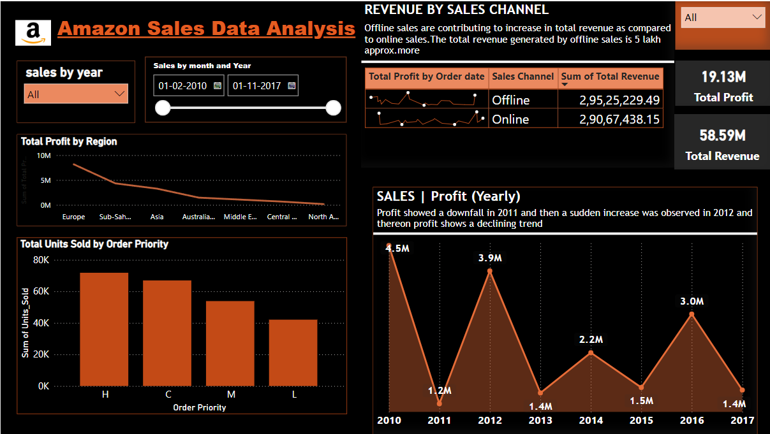

Slide 7
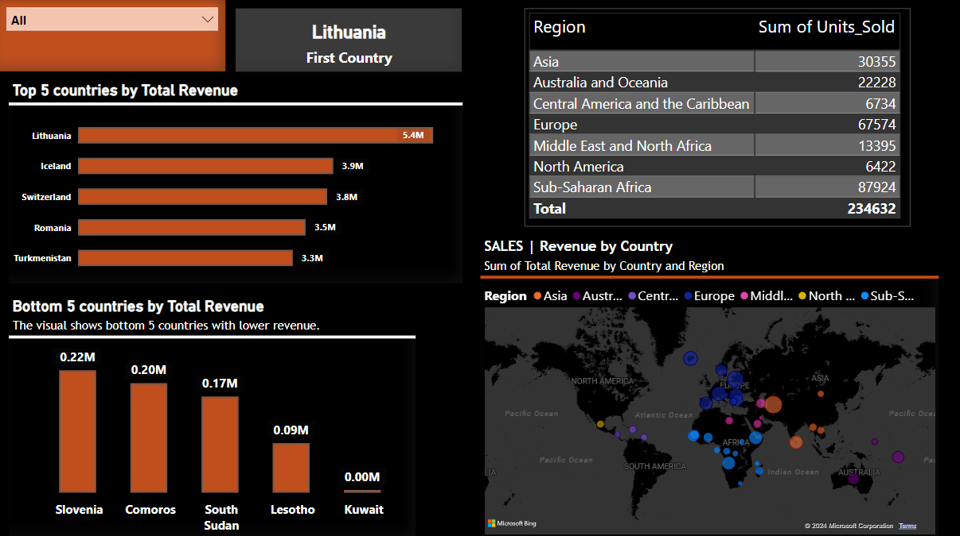

Slide 8
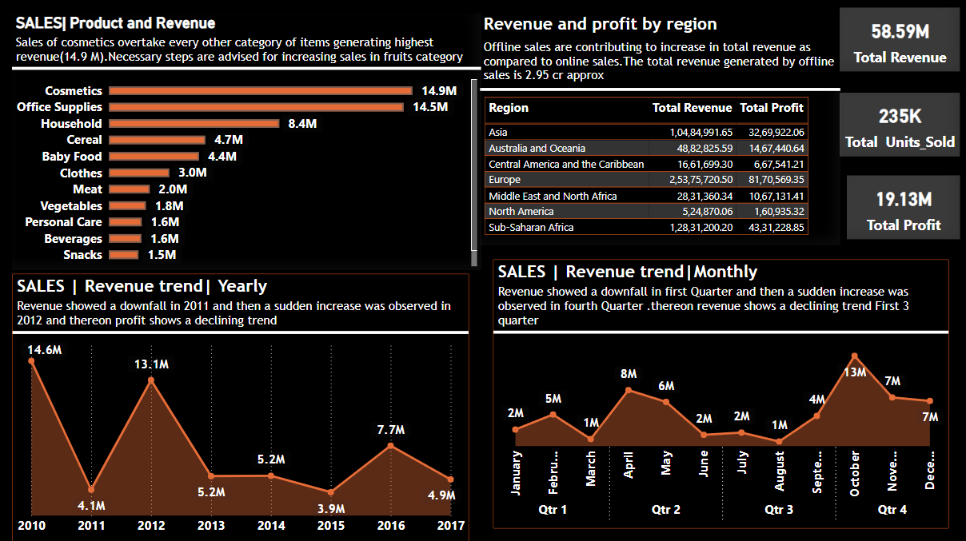

Slide 9
Data Insight
BY PRODUCT VIEW
Total revenue and profit
This shows that the total sales across all orders in the dataset amount to over 58.59million, with a total profit of more than 19.13 million. This indicates a profit margin of about 32.65%.
Highest selling product category
Sales of cosmetics overtake every other category of items generating highest revenue(14.9 M) followed by office supplies contributing to a revenue of 14.5M. Necessary steps can be taken to increase the sales in fruits and snacks category giving the lowest sales.
Revenue trend over years
Revenue showed a downfall in 2011 when it directly jumped from 14.6 M to 4.1 M and then a sudden increase of 13.1M was observed in 2012 and thereon revenue showed a declining trend over the years.
Contribution of sales channel to the revenue
It is clearly understood that offline sales channel are contributing to increase in total revenue as compared to online sales channel. The total revenue generated by offline sales is 2.95 M approx. whereas online sales is 2.90 M approx.
Profit over years
A time based analysis was performed in order to study the trend of profit over years. Profit showed a downfall in 2011 and then a sudden increase was observed in 2012 and thereon profit shows a declining trend.

Slide 10
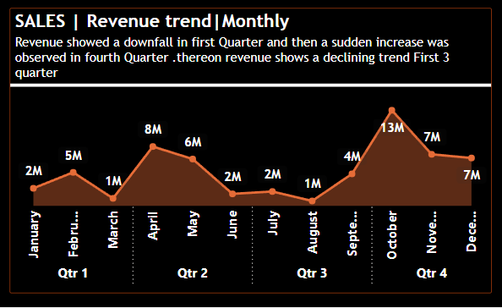
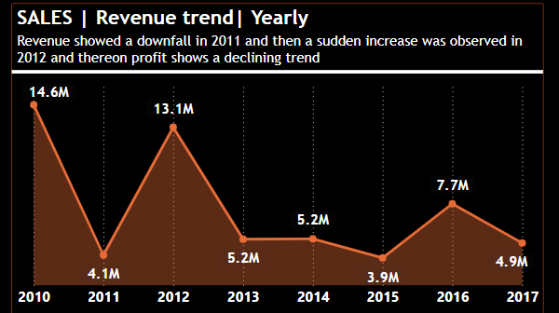
GEOGRAPHICAL VIEW Top 5 countries by revenue: Lithuania, Iceland , Switzerland, Romania and Turkmenistan are the countries generating highest revenue. Lithuania generated highest revenue of 5.4 M. The average revenue generated in these 5 countries is about 3.9M. Bottom 5 countries by revenue: Bottom 5 countries contributing to the sales Kuwait , Lesotho, South Sudan, Comoros , and Slovenia. Steps can be taken to focus on improvement of sales in these countries Revenue and Profit by region Sales Revenue trends :

Slide 11


Summary
Data analysis is an essential aspect of modern decision-making processes across various sectors
Analytical techniques used:Statistical Analysis: Applying statistical tests to understand relationships between variables. Data Visualization: Creating graphical representations of data to facilitate understanding and communication of insights.
Steps followed as:
Data Collection: Gathered relevant data from various sources. Ensure data integrity, quality, and completeness.
Data Cleaning and Preprocessing: Addressed missing values, handled outliers, and transform the data into a usable format. Cleaned and preprocessed data for ensuring the accuracy and reliability of the analysis.
Exploratory Data Analysis (EDA): Visualized distributions, identified patterns, and calculated summary statistics. (EDA helps in formulating hypotheses and refining the analysis approach.)

Slide 12




Thank you
Yogita Khillari
yogitakhillari14@gmail.com

